Slide 1

Group3: You Produce, We Sell
Han Zhang
Hang Su
Chenhao Zhang
Puxi cao
Yifan Zhou
Notes:
Hello everyone, we are group 3 and our project is you produce, we sell.

Slide 2
Problem Statement
Storage facilities
Serious post-harvest losses
Household level storage
Community warehousing
Storage pests
Management
15%-20%
lost caused by storage facilities
16%
famers think pest is a main factor
Low added value
80% smallholders
Smallholder is the mainstay
Extensive business model
Low grade processing
Notes:
In Singida, Tanzania, sorghum is largely grown due to climate condition. However, the post-harvest loses is very serious, and the shortage and unreasonable use of storage facilities accounted for about 15%-20% of the total losses. Moreover, most of the existing household level and community warehousing are also underutilized because of informal marketing. Meanwhile, the damage caused by storage pests is also serious. About 16% of farmers believe that this is the most important factor causing food losses. The surveys also show that improper management is also an important factor.
Another problem is that the agricultural product has low added value. Smallholder is the mainstay of agricultural production, accounting for more than 80% of the agricultural land used. However, Tanzania's agricultural production has been an extensive business model with low input and low output. Most agricultural products are sold as raw materials with low added values, and also in lack of sales channels.

Slide 3
Solution
Storage facilities
Establishing granaries
Low added value
Sorghum processing plants
Notes:
We hope to develop an integrated model in Singida. Building or transforming granaries and establishing sorghum processing plants closely linked to the storage facilities can reduce waste, provide stable sales channels, increase added value, create job positions, and make the products easier to sell, thereby boosting the income of farmers and workers. Next Chenhao will talk about our solution on storage facilities.

Slide 4
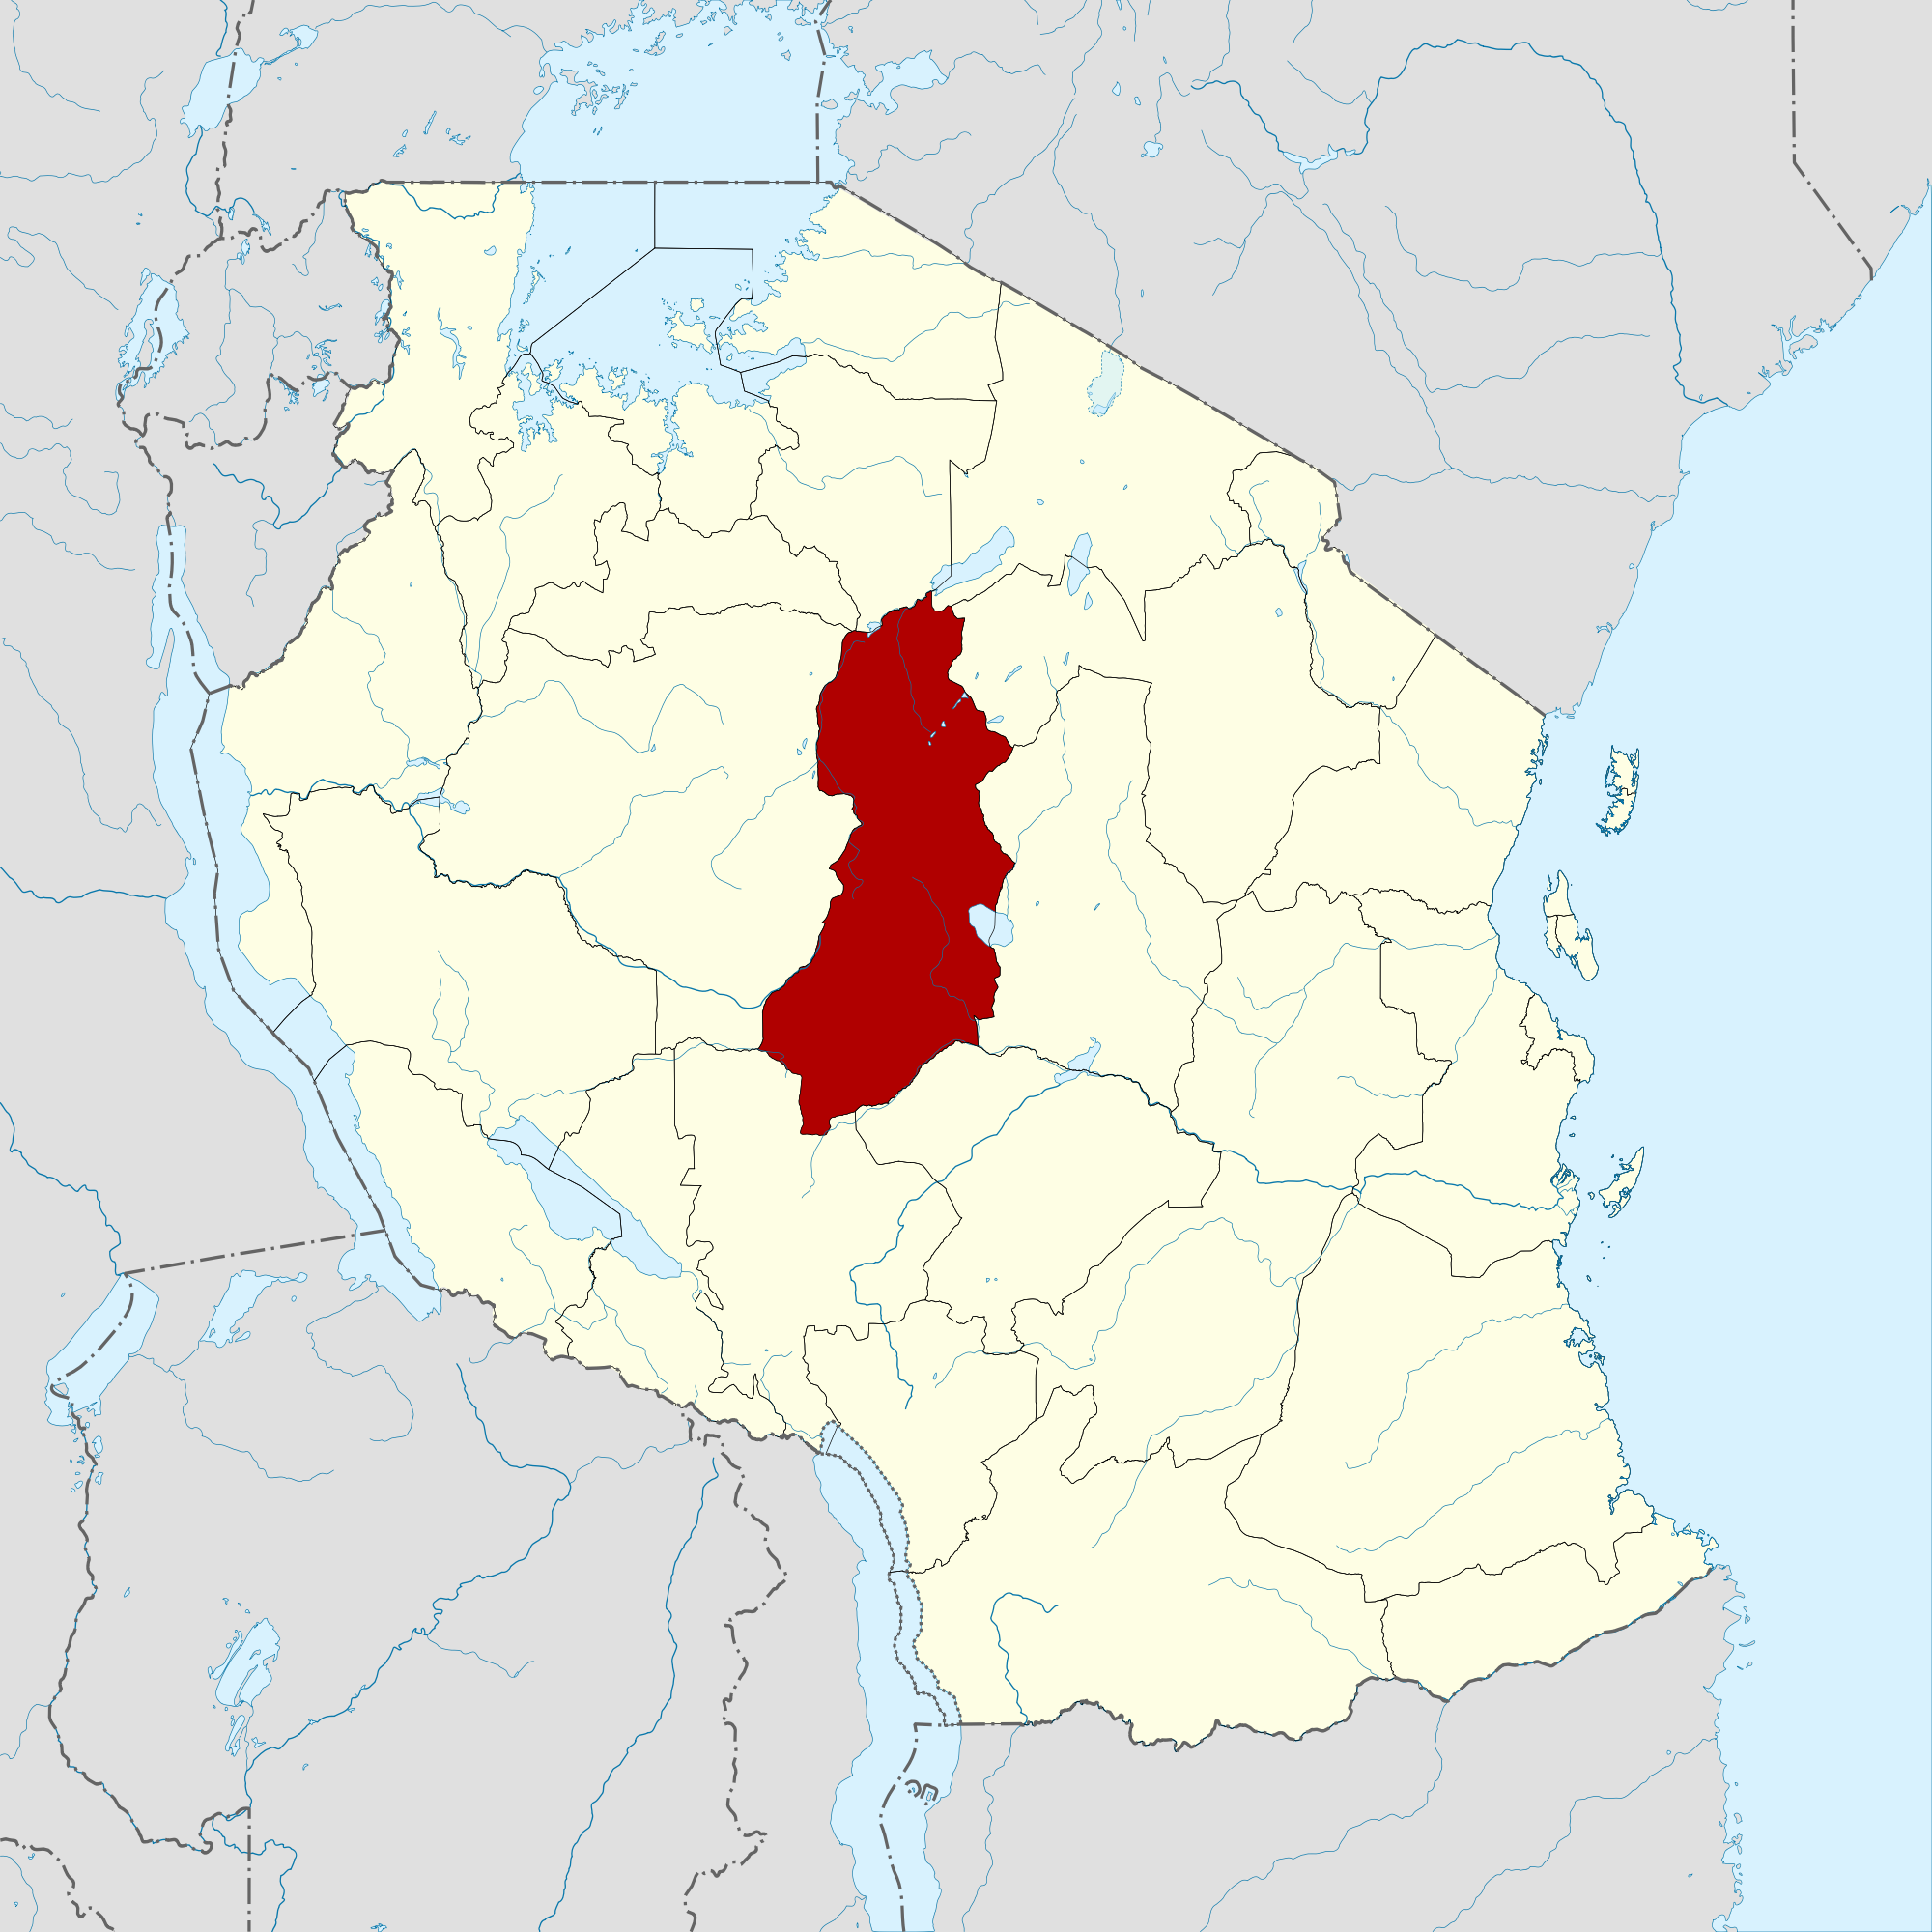
Solution I: Improved Granaries in Tanzania
Target food: sorghum
Location: Singida
Granaries + Market

Slide 5
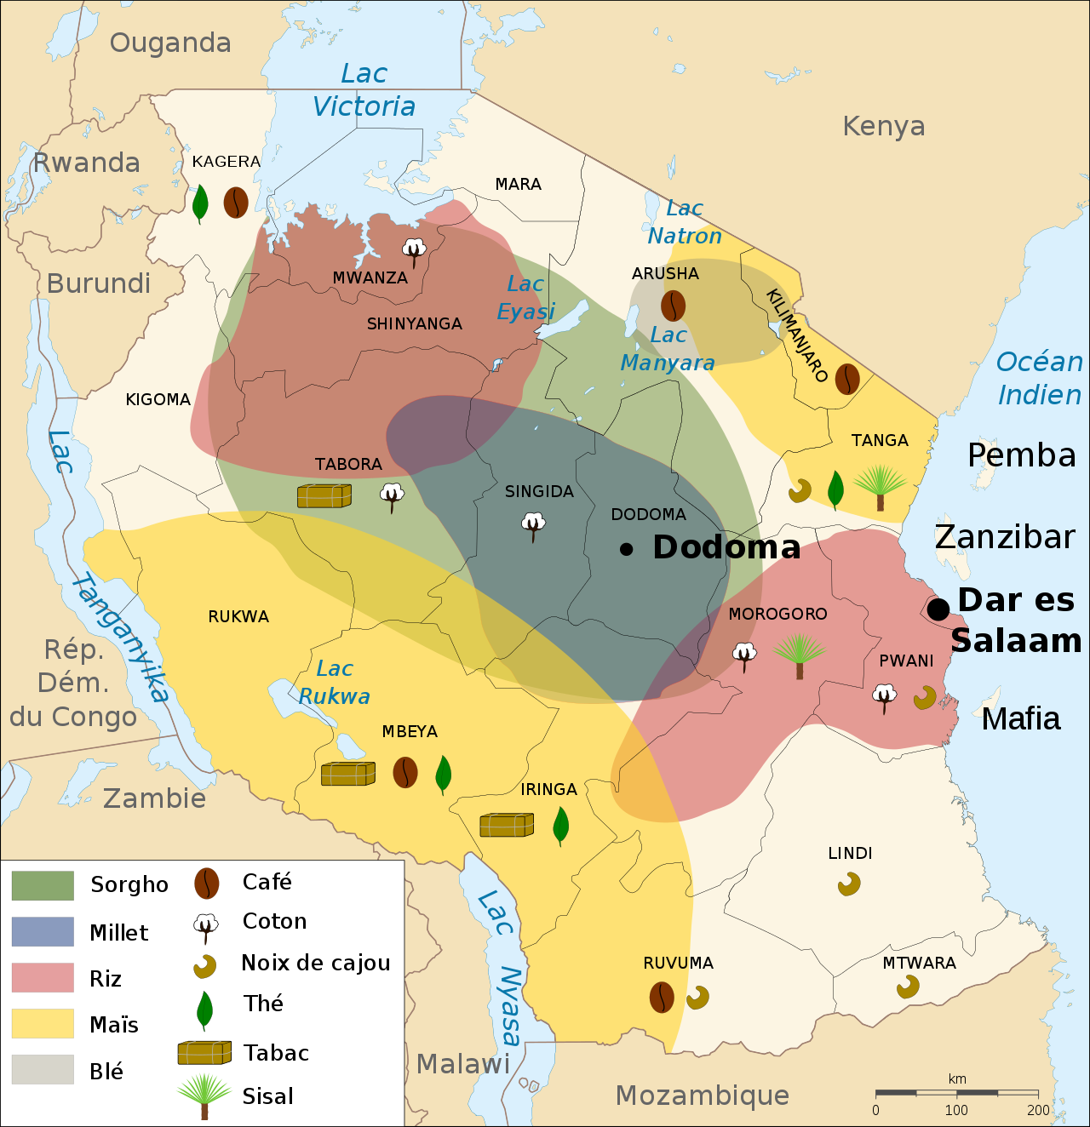
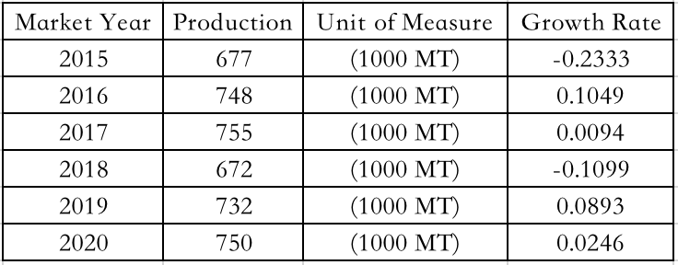
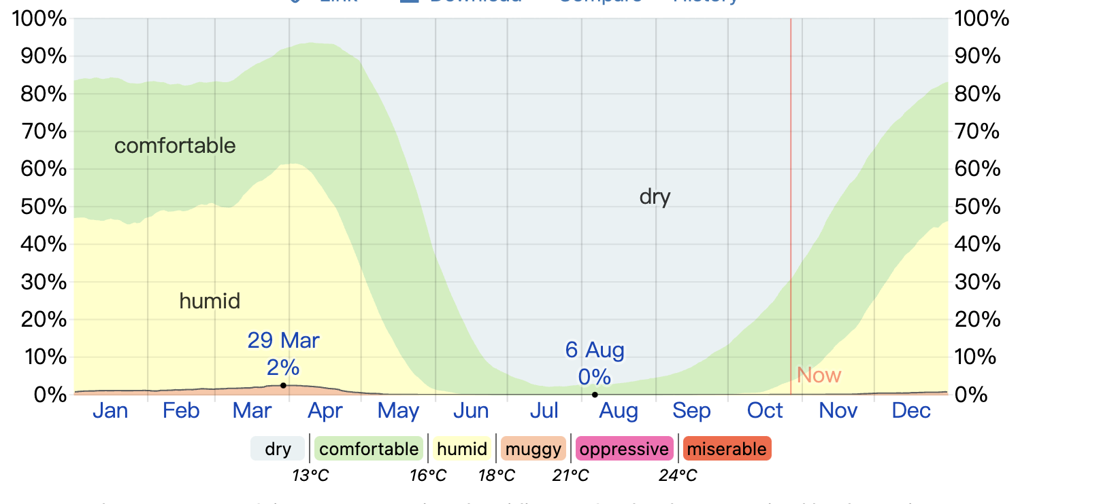
Solution I: Improved Granaries in Tanzania
Reason
Sorghum: large yield
Singida: Close to Original areas
Singda: suitable climate

Slide 6
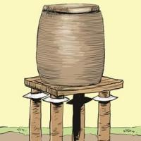
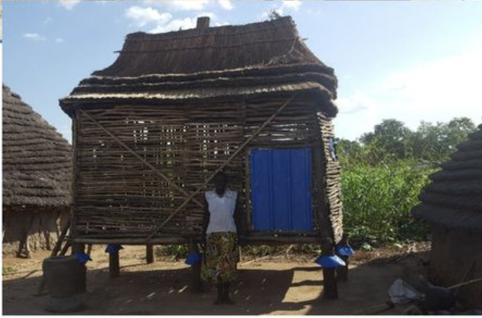
Solution I: Improved Granaries in Tanzania
How to do it
kihenge
Improved-granaries in Mozambique
Source of funds: Allocation from NMB

Slide 7
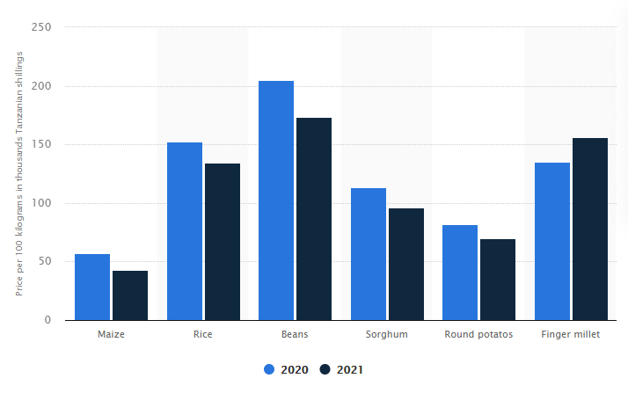


Solution II: Sorghum processing plants
low commercial value

Slide 8
8
Solution II: Sorghum processing plants
Railway
Road network
Sorghum beer
cookie
Broad market
Transportation
Higher Commerical Value
lower requirements
Stable output
Processing equipment
labor
Sufficient supply

Slide 9
Prototype: Cooperation
Cheaper sorghum
Building warehousing
Warehousing and factory will belong to investor
until farmers fulfill their responsibilities.
Investor
Small
farmers
Building factory
Cheaper labors
Farmers must provide specified amounts of products.
Stable supply
Hiring local people

Slide 10
Prototype: Benefits for investors
Transportation cost
Warehousing → Processing
Processing → Selling
Warehousing cost
COMPETITION
ON MARKET
Management cost
Semifinished products
Available cheap labor
Purchasing cost
.Cheaper raw materials

Slide 11
Prototype: Benefits for local small farmers
Alleviate wasting
Job opportunities
More profit
Better warehousing
&
Primary processing
Warehousing work
&
Factory work
Better productivity
&
Processing ability

Slide 12

Conclusion
Background and problem review
Problem with the sorghum production
low input, low yield, the low added value of the raw products, extreme lack of modern and effective storage facilities, and sales channels resulting in heavy post-harvest loss have been marking the feature of sorghum production in Singida.
Advantages of Singida
Central Railway hub of Tanzania providing convenient transportation infrastructure.
The main sorghum production area in Tanzania

Slide 13
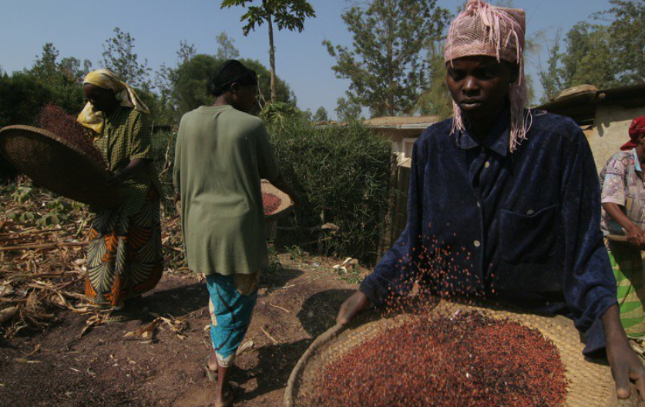
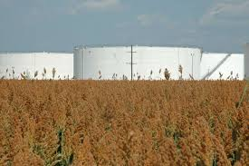
Conclusion
Solution and prototype review
Improved storage facilities
Improved local granaries called kitenge having capacity from 1 to 5 tonnage and Mozambique granaries capable of preventing pests
Speeding up sorghum processing plants
Compared with the raw products, processed sorghum (sorghum can be made into biscuits, cakes, vegetarian porridge, and beer) has a higher added value and has a much broad market all over Tanzania and Africa.
Seek client and investment
Client can save cost on transportation and management
Purchasing cost lowering for client after investment
Increase local employment and improve local economic sustainability

Slide 14
Thank You !

Slide 15
Reference
Foreign Economic Cooperation Center of the Ministry of Agriculture of China 2018, Conditions and Characteristics of Tanzania's Agricultural Development, viewed 20 October 2021, http://www.agri.cn/V20/ZX/sjny/201811/t20181113_6283410.htm
Taruvinga, C 2018, Tanzania Cereal Storage Scoping Mission, viewed 20 October 2021, https://www.canr.msu.edu/fsp/news/Paper_2.1._FAO_Cephas_Taruvinga.pdf
Abass, AB, Ndunguru, G, Mamiro, P, Alenkhe, B, Mlingi, N & Bekunda, M, 2014, Post-harvest food losses in amaize-based farming system of semi-arid savannah area of Tanzania, Journal of Stored Products Research, Vol. 57, pp. 49-57, viewed 20 October 2021, https://core.ac.uk/download/pdf/82311085.pdf

